Slide 1



2020
Organized by

Slide 2

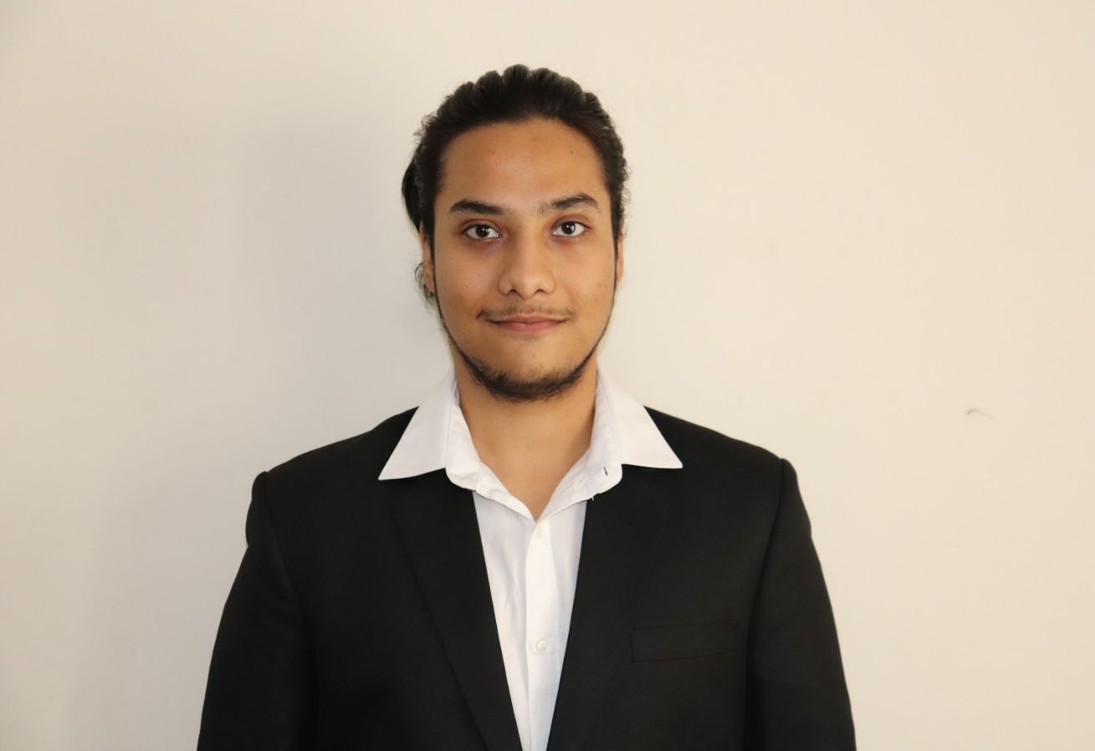
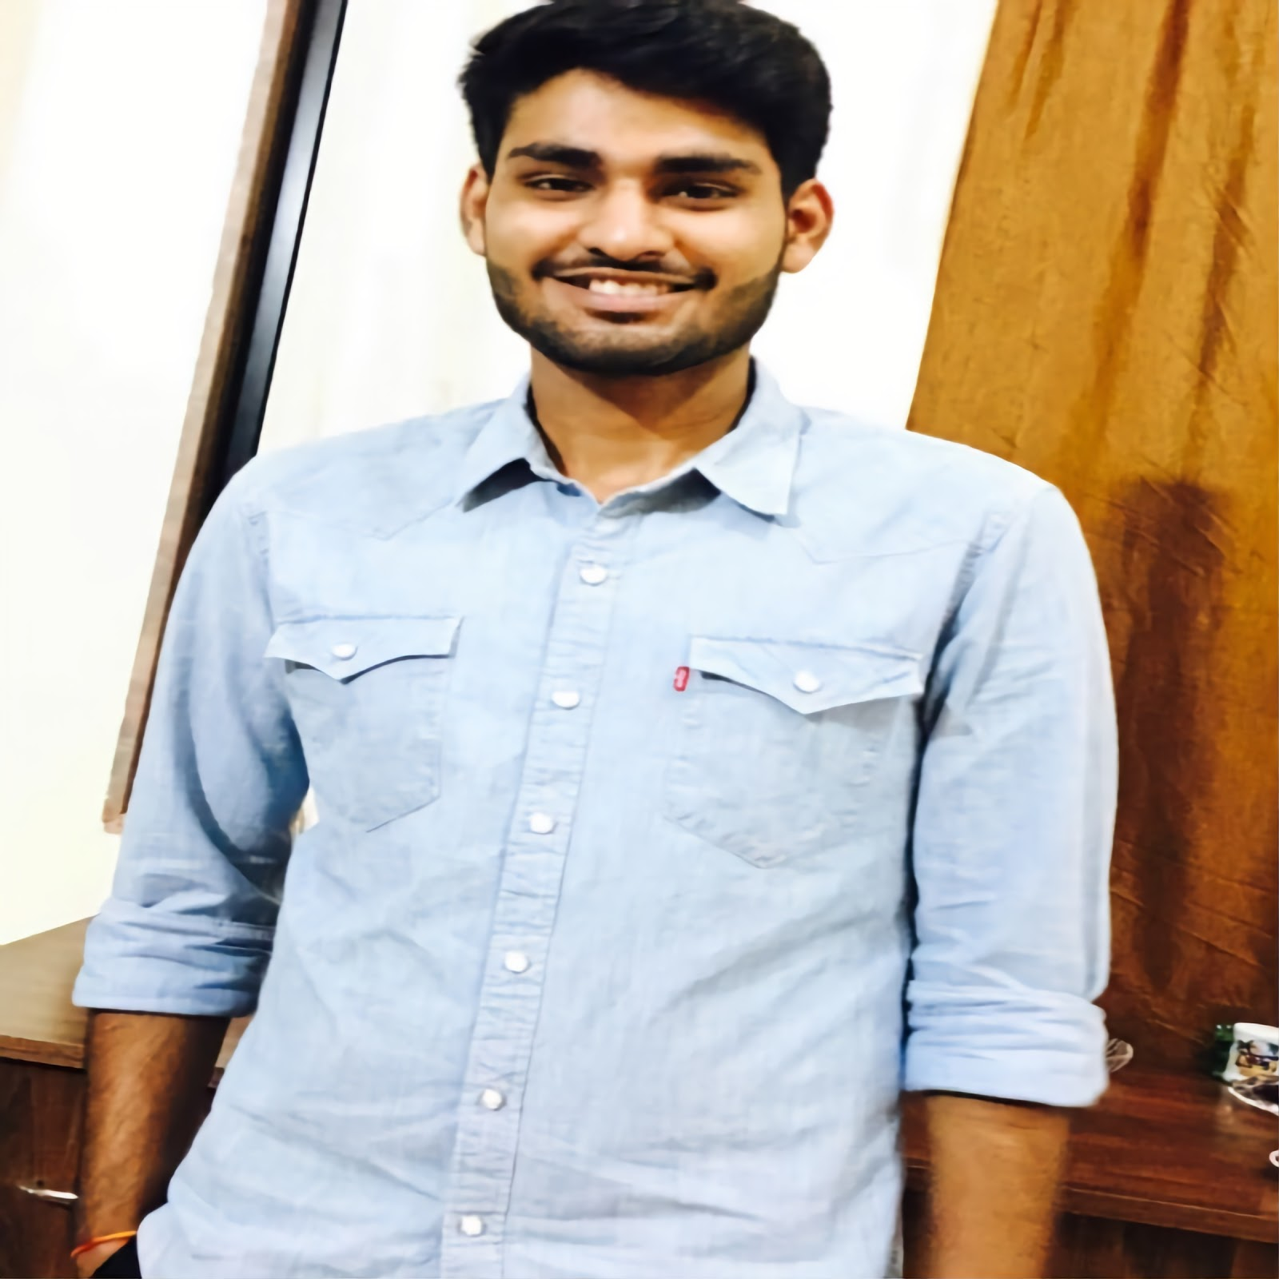

ONE TAP UPDATER An OCR App that automates hand-filled form updates
VARISHU PANT
Class of 2020
Praxis Business School
ANKIT SEKSERIA
Class of 2020
Praxis Business School

Slide 3
BRIEF DESCRIPTION OF PROJECT
Premise
Many organizations like banks and insurance companies give customers empty forms to submit their applications. The applicants fill in the applications and submit them. But eventually, the handwritten data from these forms is needed to be fed into the machine.
About our product
Our product can help these organizations in updating the contents of these forms in spreadsheets with just a single click.
Note:
In this project, we have considered a particular case and shown how this system can work for updating student registration forms of a college.
We have used image processing techniques like dilation, adaptive thresholding , and Gaussian blur to remove noises and used contours to detect the boxes in the form. We trained these boxes on a modified Resnet architecture to get the final model.

Slide 4

AGENDA
INTRODUCTION
Problem Statement
Objective
PROJECT METHODOLOGY
Overview
Deep Dive
FUTURE PROSPECTS
Deployment
Scope
AGENDA

Slide 5



PROBLEM STATEMENT
Several institutions, like banks and colleges, use paper forms that have to be filled in by the applicants. These have to entered manually into their respective databases. This exercise is error-prone and consumes a lot of resources. Can this process be redesigned to minimize errors and the use of resources?

Slide 6
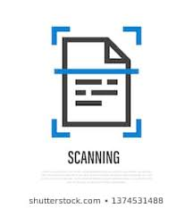


OBJECTIVE
To create an application that enables a reliable, secure, fast and automated conversion of scanned handwritten forms to excel sheets, thereby minimizing error and use of resources.
Scanned Images.
Outputs a Excel file.
One Tap Updater.

Slide 7



HIGH LEVEL REPRESENTATION OF THE PROJECT
Collecting Hand filled forms
Storing the scanned forms as image files
Pre-processing, prediction in the app
Outputs the information in an Excel file.
Scanning these forms at 300 dpi

Slide 8


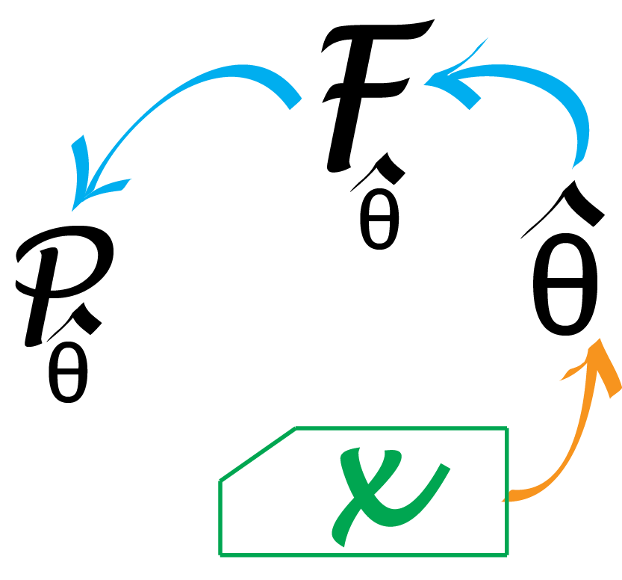
PROCESS FLOW
Modeling
Data Collection
Conversion

Slide 9
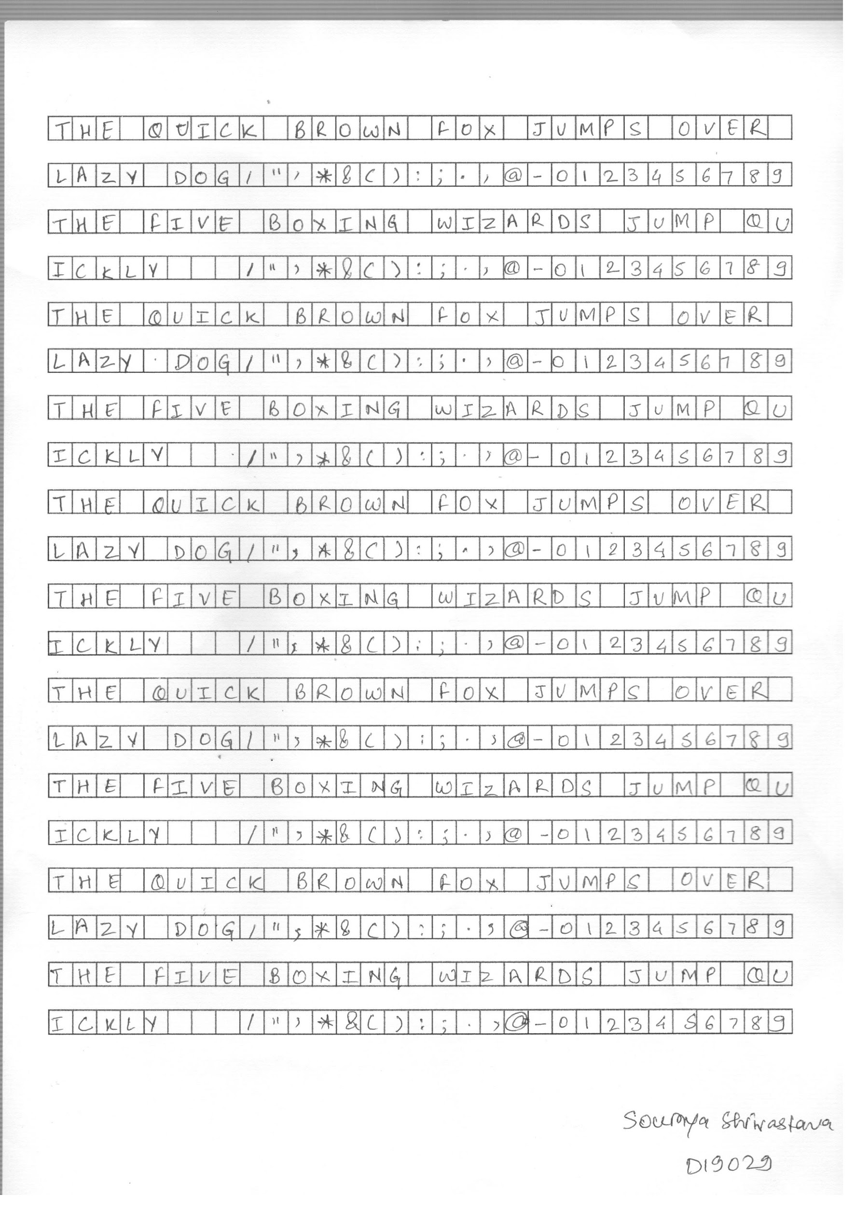
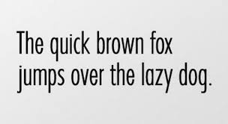


DATA
Created a Standard Form Template:
Used 2 sentences that contain all 26 letters of the English alphabet
Digits from 0-9 and
special characters were also incorporated
LETTERS:
NUMBERS:
SPECIAL CHARACTERS:

Slide 10
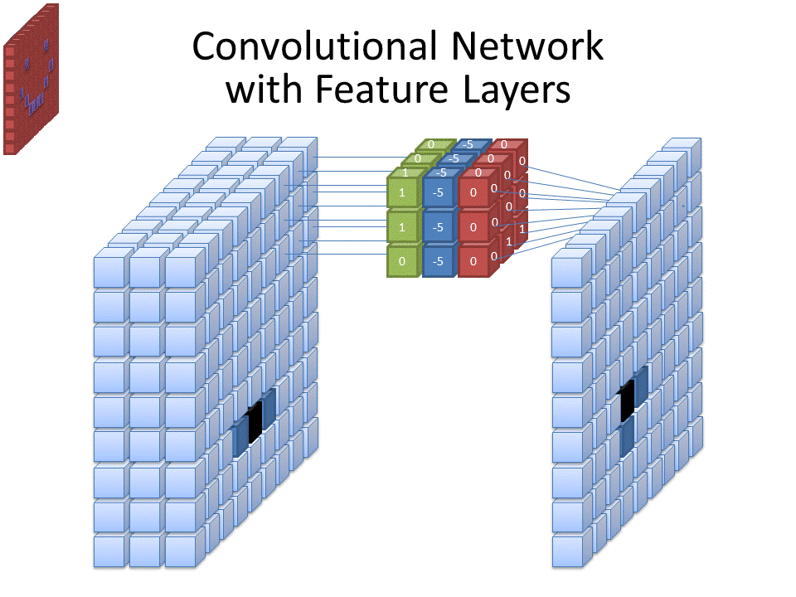
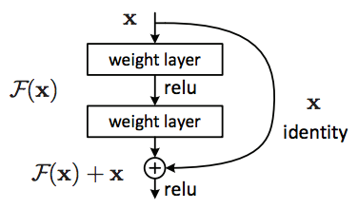
MODELING
TRAIN-TEST SPLIT
26 Letters + 10 Digits + 11 Special Characters= 47 Classes
Training [Batch’ 20 + NIST] = 21,540 + 98,000 = 1,19,540 images
Validation [Batch’19] = 13,047 images
ResNet Architecture
SHAPE OF CHARACTER IMAGES
From Students- 65*65 [Resized]
From NIST dataset- 128*128 [Cropped]
Reshaped to 78*78 for training DL architecture

Slide 11
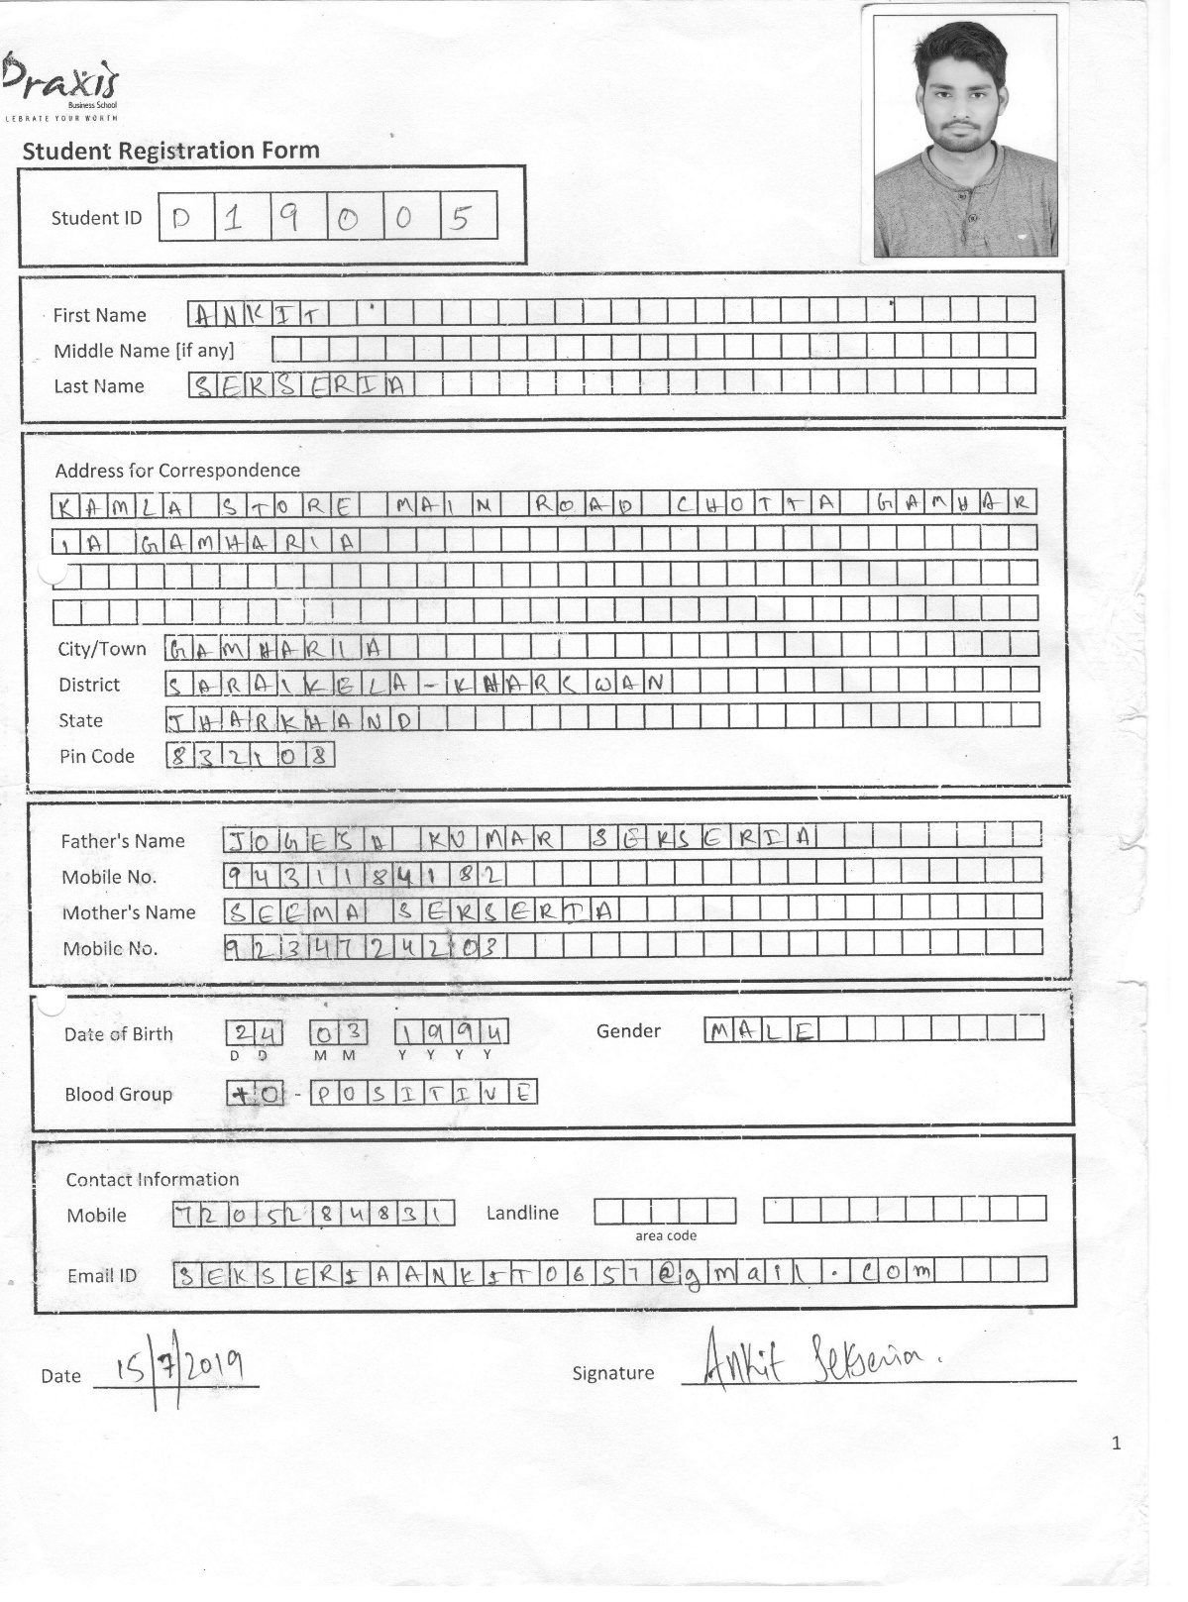
CONVERSION
Information of the student contained in the form gets mapped to a single row in the spreadsheet. When performing batch update, each row refers to a single student.

Slide 12



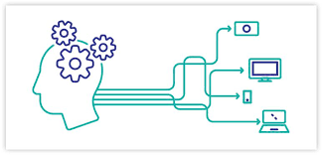



STAGES OF THE PROJECT
Data Collection
Character Extraction
Training
Deploying Prototype
Data Pre-Processing

Slide 13
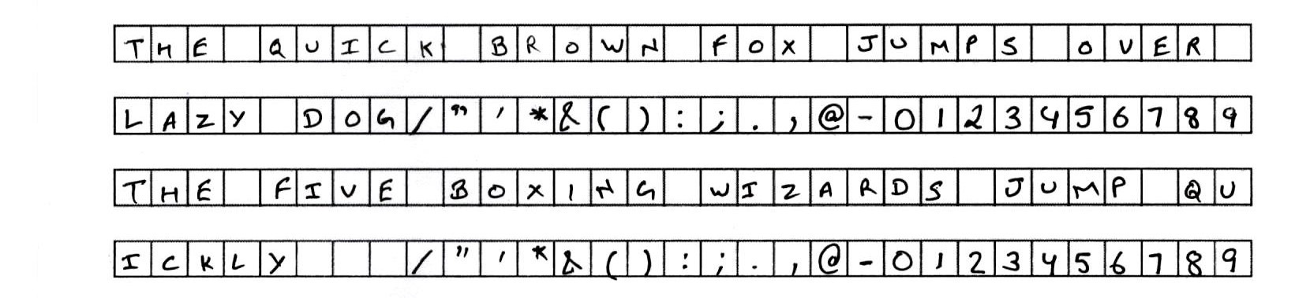
DATA COLLECTION
These 4 lines are repeated 5 times in every form.
Forms must be scanned at 300 dpi for better contour detection.
Collected data in 3 batches in order to capture variations in handwriting.

Slide 14
STAGES OF THE PROJECT
Data Collection
Character Extraction
Training
Deploying Prototype
Data Pre-Processing

Slide 15
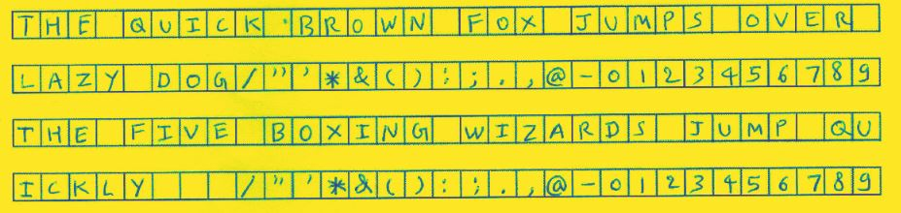
PREPROCESSING – Overview
Image read in grayscale mode
An image is made up of pixels and each of these pixels is associated with a pixel value which represents its brightness and color.
A grayscale image is one in which all pixels have values that correspond to only the brightness of the pixel.
Pixel values range from 0 to 255, where 0 is considered as absence of light or black and 255 is considered to be representing white. All values in between represent different shades of gray.

Slide 16
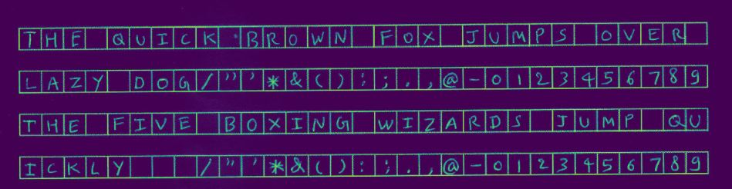
PREPROCESSING – Binarization
Binarized Form
For the process of binarization, the image must be in grayscale
A threshold is chosen, and each pixel having a value greater than that threshold is given a value of 255 whereas each pixel with a value less than or equal to the threshold, is given a value of 0.
This leads to the image converting into a black and white image or binary image
For text related documents, the technique of binarization is often applied to help localize the text against the background

Slide 17
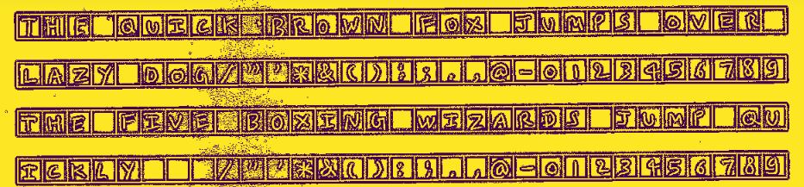
PREPROCESSING – Thresholding
Thresholded Form
The process of assigning pixel values using the given threshold, is called thresholding.
We used Adaptive Thresholding where the threshold for each pixel is set locally based on some small region around the pixel instead of globally as in the case with Simple Thresholding.
For the forms, the threshold we used was the Gaussian weighted sum of neighborhood values
For the character images though, the threshold we used was the mean of neighborhood pixel values.
Purpose- to increase the relevant area so as to make character pop out.

Slide 18
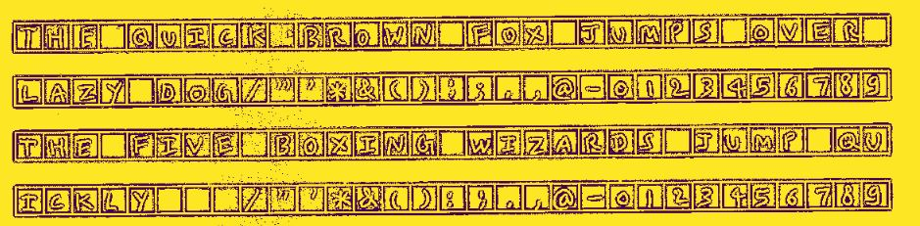
PREPROCESSING – Dilation
Dilated Form
We set a kernel size that convolves the image and adds white pixels around the boundary of the character
We found that dilating through asymmetric kernel sizes like (10,3) and (3,10) helped in getting the subsection boxes.
We hypothesize this may be due to our contours being square shaped.
In case of detecting the outer rectangles, symmetric kernel sizes like (2,2) worked best
Purpose- to remove pixel noise through blurring

Slide 19
STAGES OF THE PROJECT
Data Collection
Character Extraction
Training
Deploying Prototype
Data Pre-Processing

Slide 20
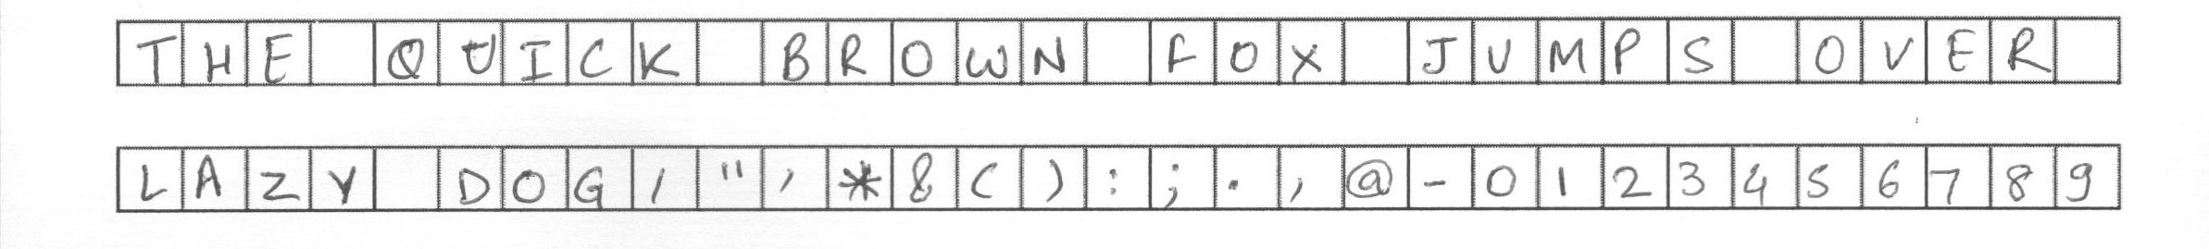









CHARACTER EXTRACTION
Detected contours and extracted –
first the outer boxes (or rectangles) and then
the inner boxes (or squares) that contain the characters.
Characters were sorted according to pixel coordinates to get the correct order for ease of storage and labelling.
After repeating noise removal steps for contours along with smoothening techniques, we get:

Slide 21
STAGES OF THE PROJECT
Data Collection
Character Extraction
Training
Deploying Prototype
Data Pre-Processing

Slide 22
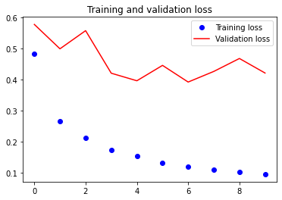
TRAINING
Data Augmentation Techniques
Shear and Zoom [To handle variations in handwriting]
Trained ResNet from scratch:
Epochs=10
Rotation [To handle form-tilt]
Batch Size=32
Optimizer=Adam
Loss Metric=Categorical Cross Entropy
Time Per Epoch=437 seconds
Validation Accuracy: 88.5%
Learning rate= 0.001

Slide 23
STAGES OF THE PROJECT
Data Collection
Character Extraction
Training
Deploying Prototype
Data Pre-Processing

Slide 24


DEPLOYING PROTOTYPE
Used TkInter to create the GUI and Pyinstaller to convert it into an executable file
Used Tkinter in python to build GUI.
Used pyinstaller to convert python file into an executable file.

Slide 25
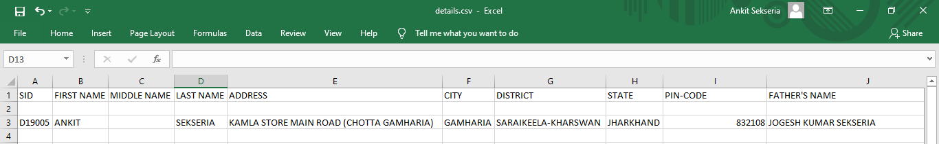
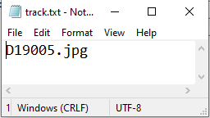
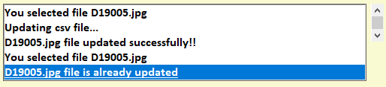
DEPLOYING PROTOTYPE
Excel Output
Avoiding duplicate updation.
By keeping track of the file already updated.

Slide 26
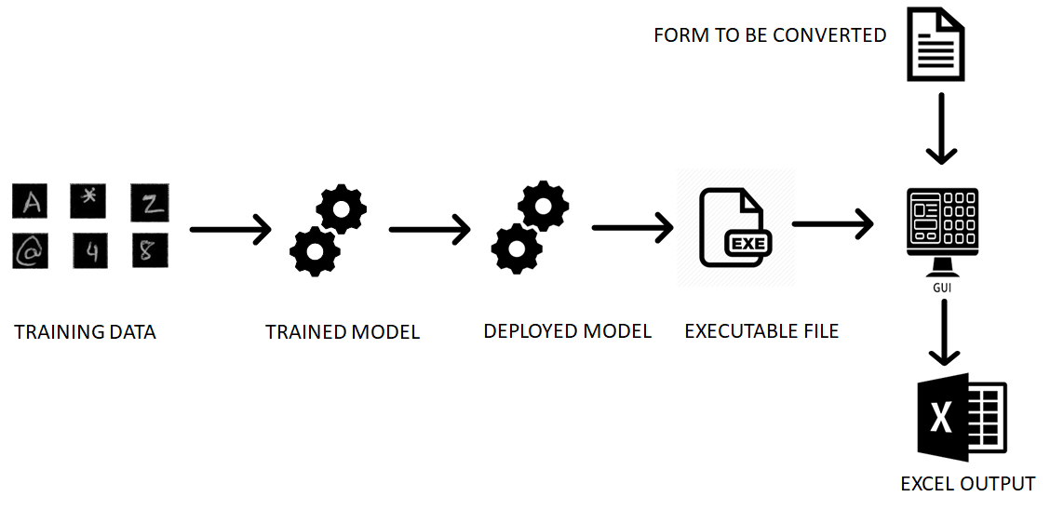
DEPLOYMENT PROCESS

Slide 27
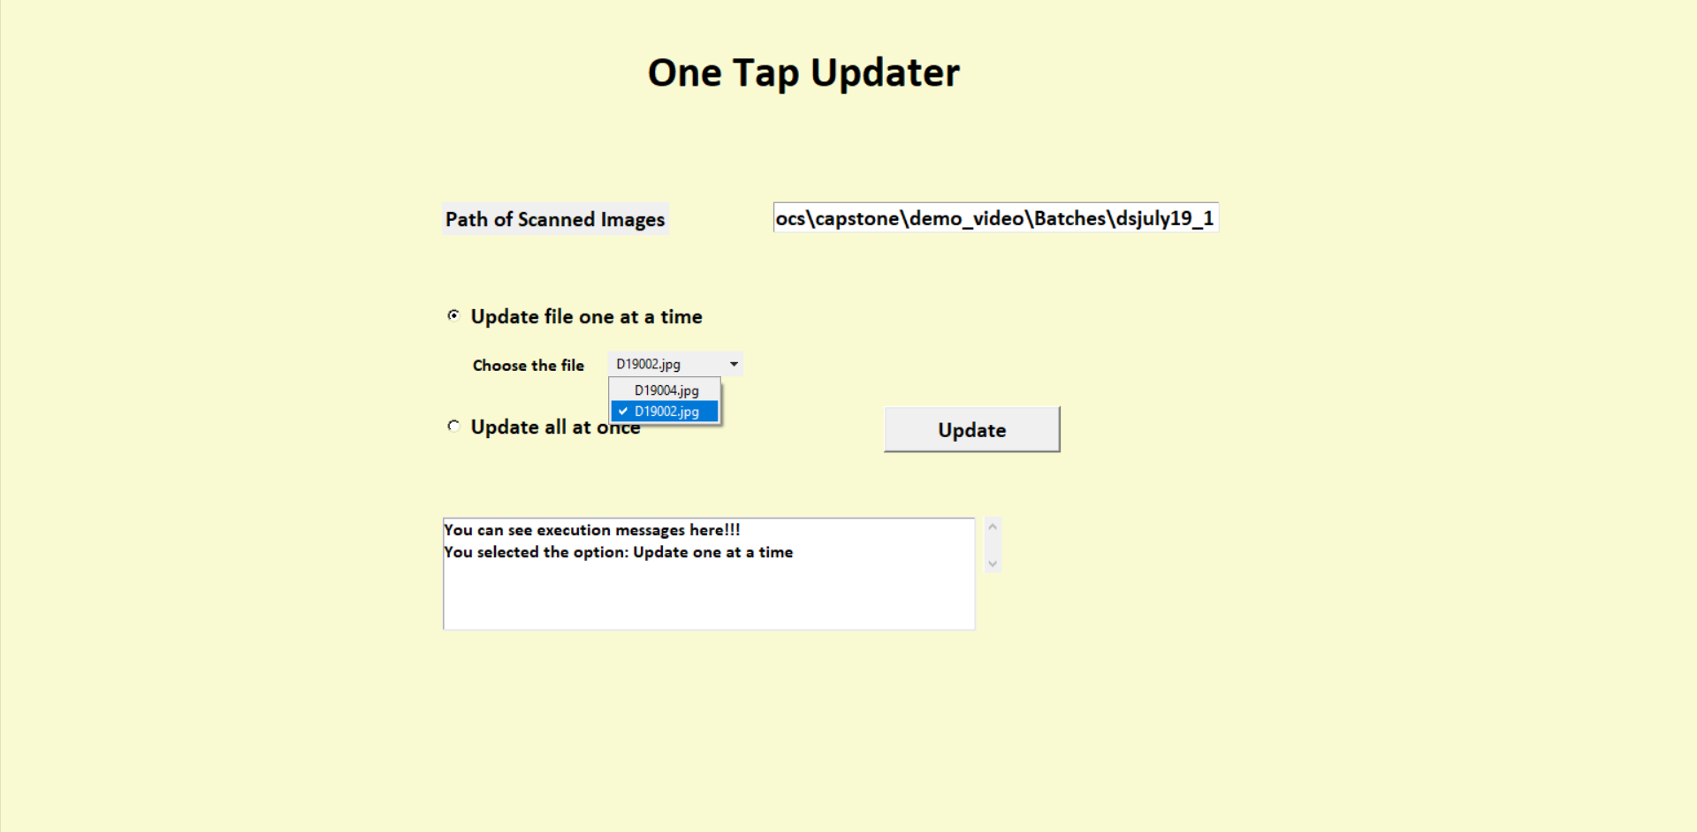

FINAL PRODUCT
1
2
3
4

Slide 28
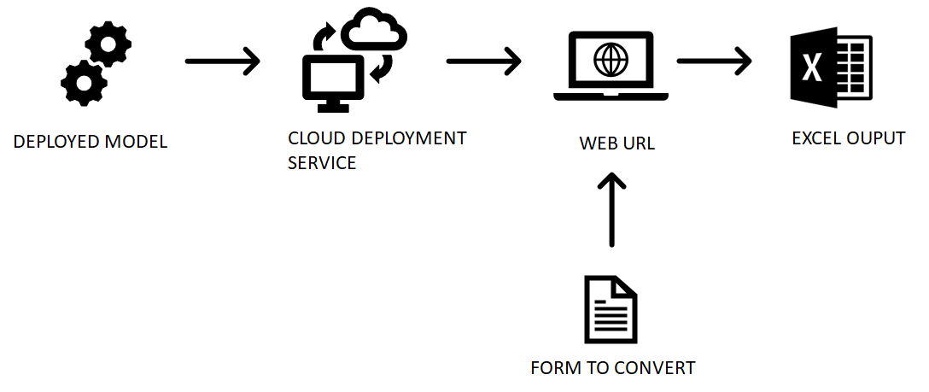
FUTURE DEPLOYMENT

Slide 29
JOURNEY AND EXPERIMENTATION
Contour Detection
Canny Edge -Not helpful when there are hierarchies to be considered in coordinates. [Boxes inside rectangles]
Boundary Rect -Letters like B and D were getting detected as contours.

Slide 30
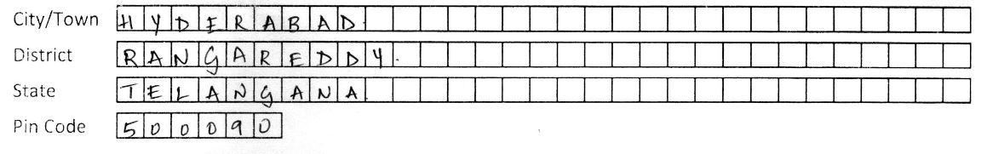
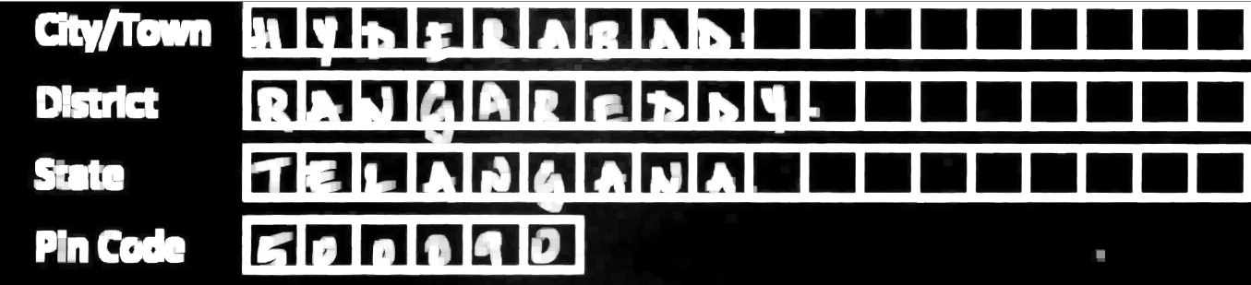
JOURNEY AND EXPERIMENTATION
Contour Detection
Canny Edge -Not helpful when there are hierarchies to be considered in coordinates. [Boxes inside rectangles]
Boundary Rect -Letters like B and D were getting detected as contours.
Wear and Tear of Forms
Due to breaks in the boundary lines, some boxes were not getting detected.
Breaks
Thick and complete boundaries
Pre-processing

Slide 31
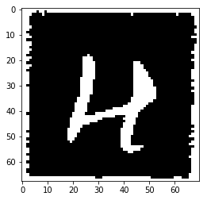

JOURNEY AND EXPERIMENTATION
Contour Detection
Canny Edge -Not helpful when there are hierarchies to be considered in coordinates. [Boxes inside rectangles]
Boundary Rect -Letters like B and D were getting detected as contours.
Wear and Tear of Forms
Due to breaks in the boundary lines, some boxes were not getting detected.
Inconsistent White Boundaries
Training data had white boundaries as shown and the model had used that boundary as a feature to train. But this boundary was absent during inference time and hence the accuracy dropped.
Breaks
Thick and complete boundaries
Pre-processing
Smart cropping

Slide 32
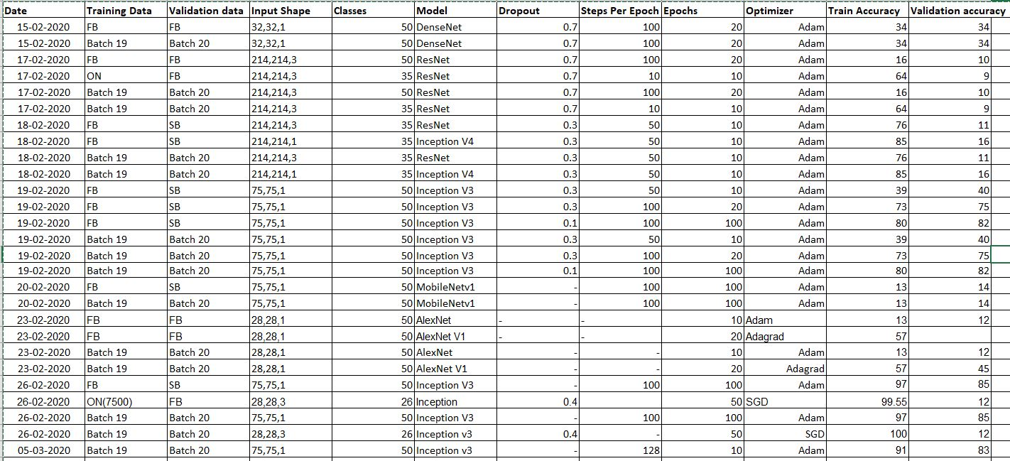
MODEL EXPERIMENTATION

Slide 33
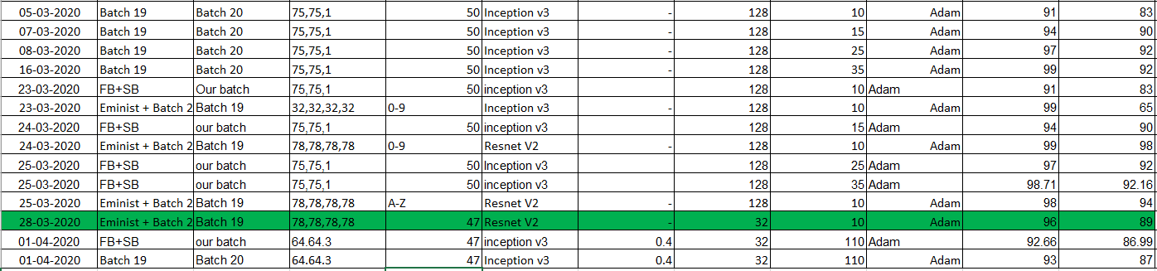
JOURNEY AND EXPERIMENTATION
Time taken for conversion was huge and not scalable for large amounts of files during batch update. To overcome this, we took 2 steps:
Removed 4 classes that were not encountered even once. [ " ' ; *]
2. Instead of using multiple models, we used only one [ Highlighted above ]
Implemented custom rules for different sections in the form.

Slide 34
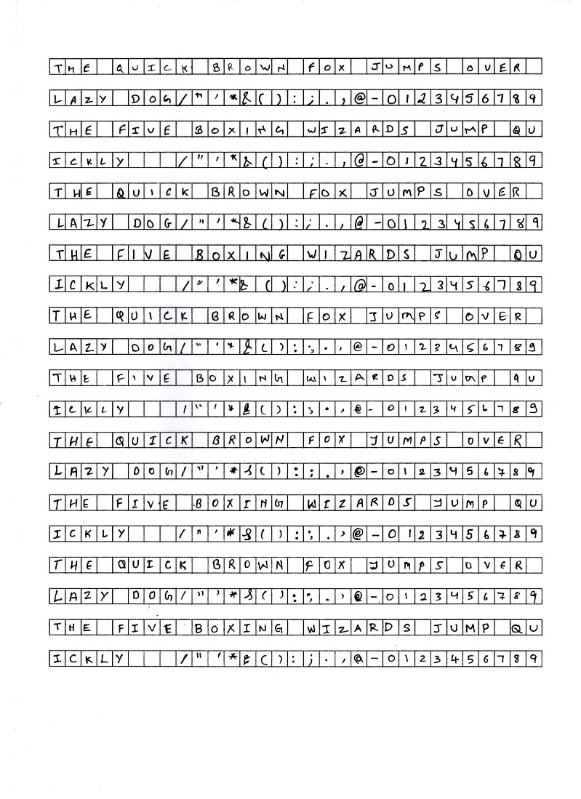
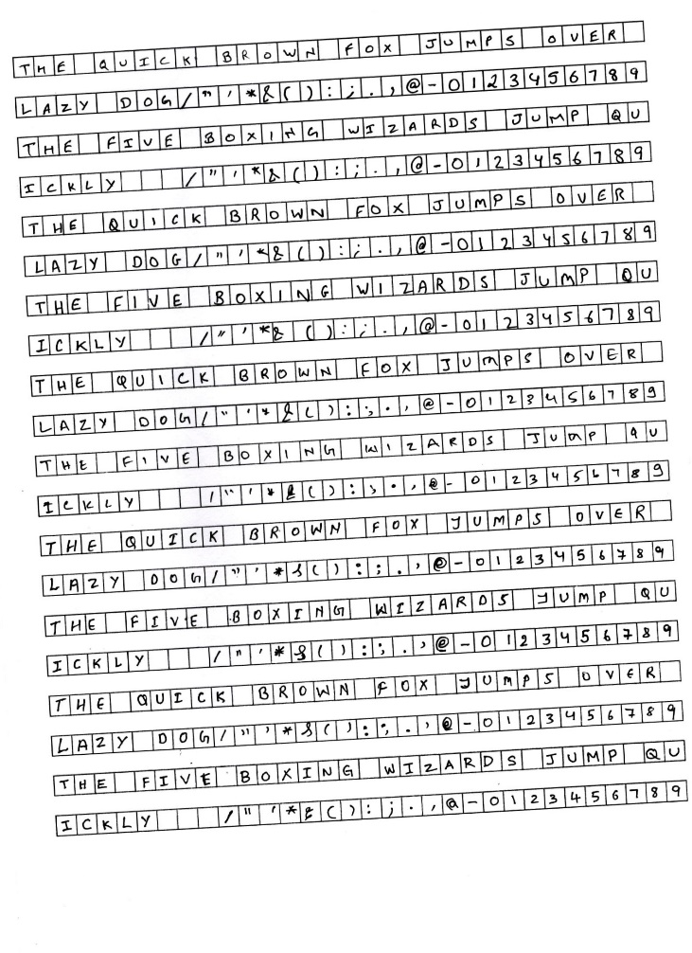
JOURNEY – Accidental Form Tilt During Scanning
Handling tilt during data collection-
A broad white margin on all 4 sides was incorporated in the standard form template
During character extraction, sorting was performed with some error margin
Handling tilt during inference-
During training, images rotated to handle tilt during inference

Slide 35
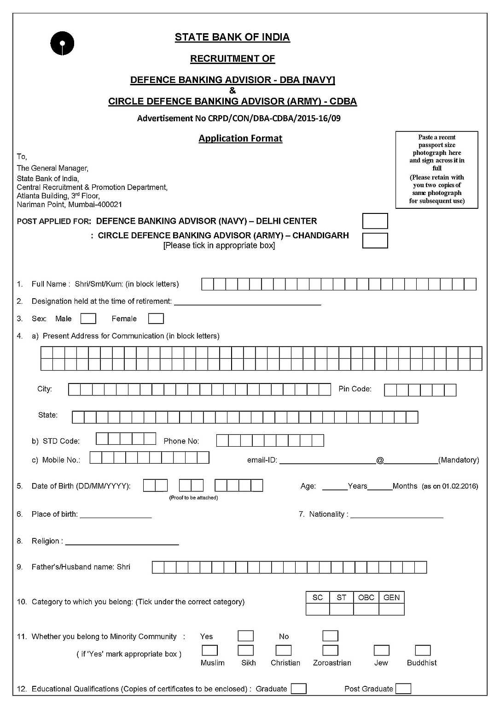
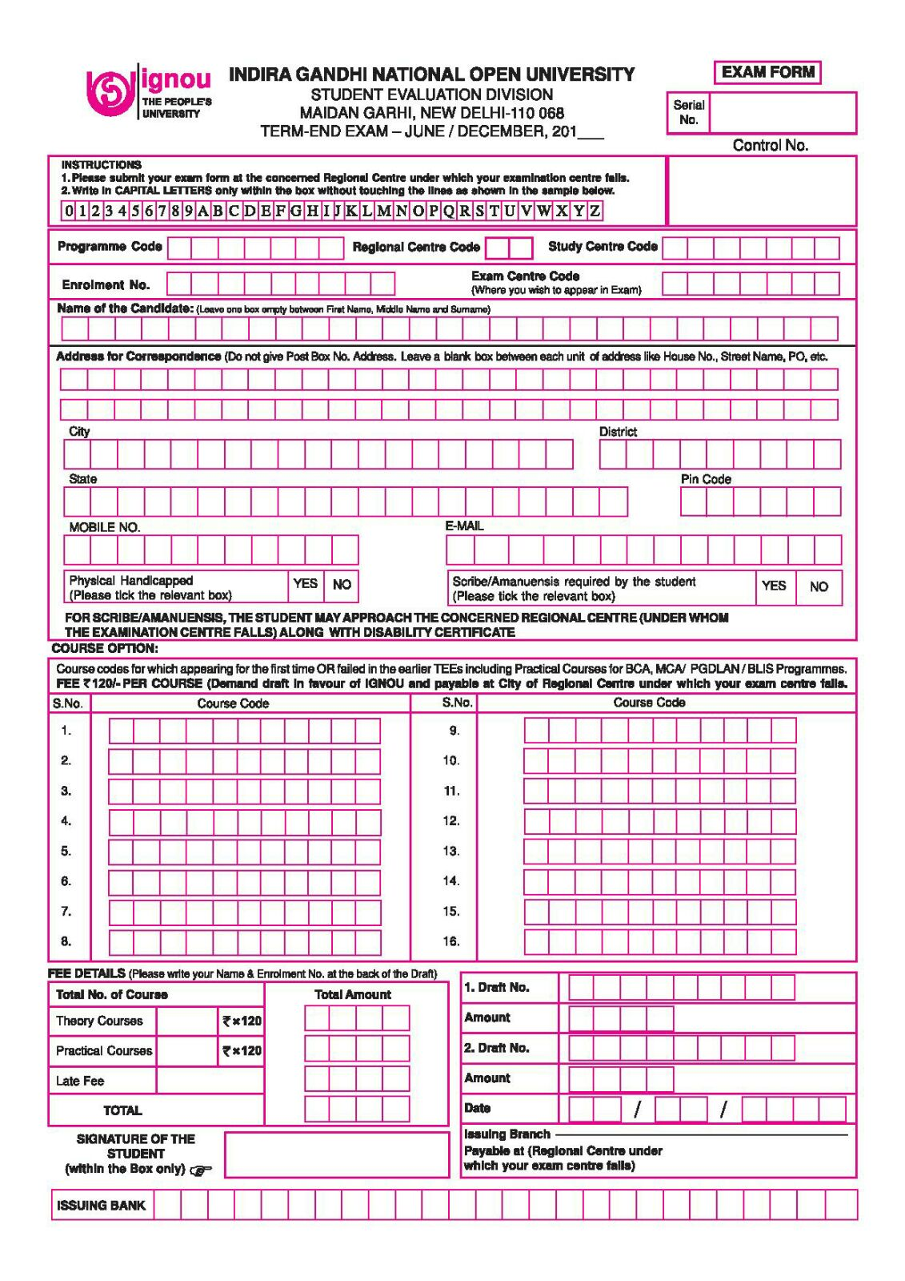
SCOPE
Potential updates:
Adding in small letters of the English alphabet
Adding in multiple languages
Adding more special characters to make it versatile
There are a lot of organisations that use handwritten forms and can benefit from One Tap Updater .
Some Examples are :
Bank Recruitment forms (State Bank of India Form displayed)
University application forms (IGNOU Form displayed)

Slide 36

ACKNOWLEDGEMENTS
Thanks to Praxis Business School for giving us this learning opportunity.

Slide 37
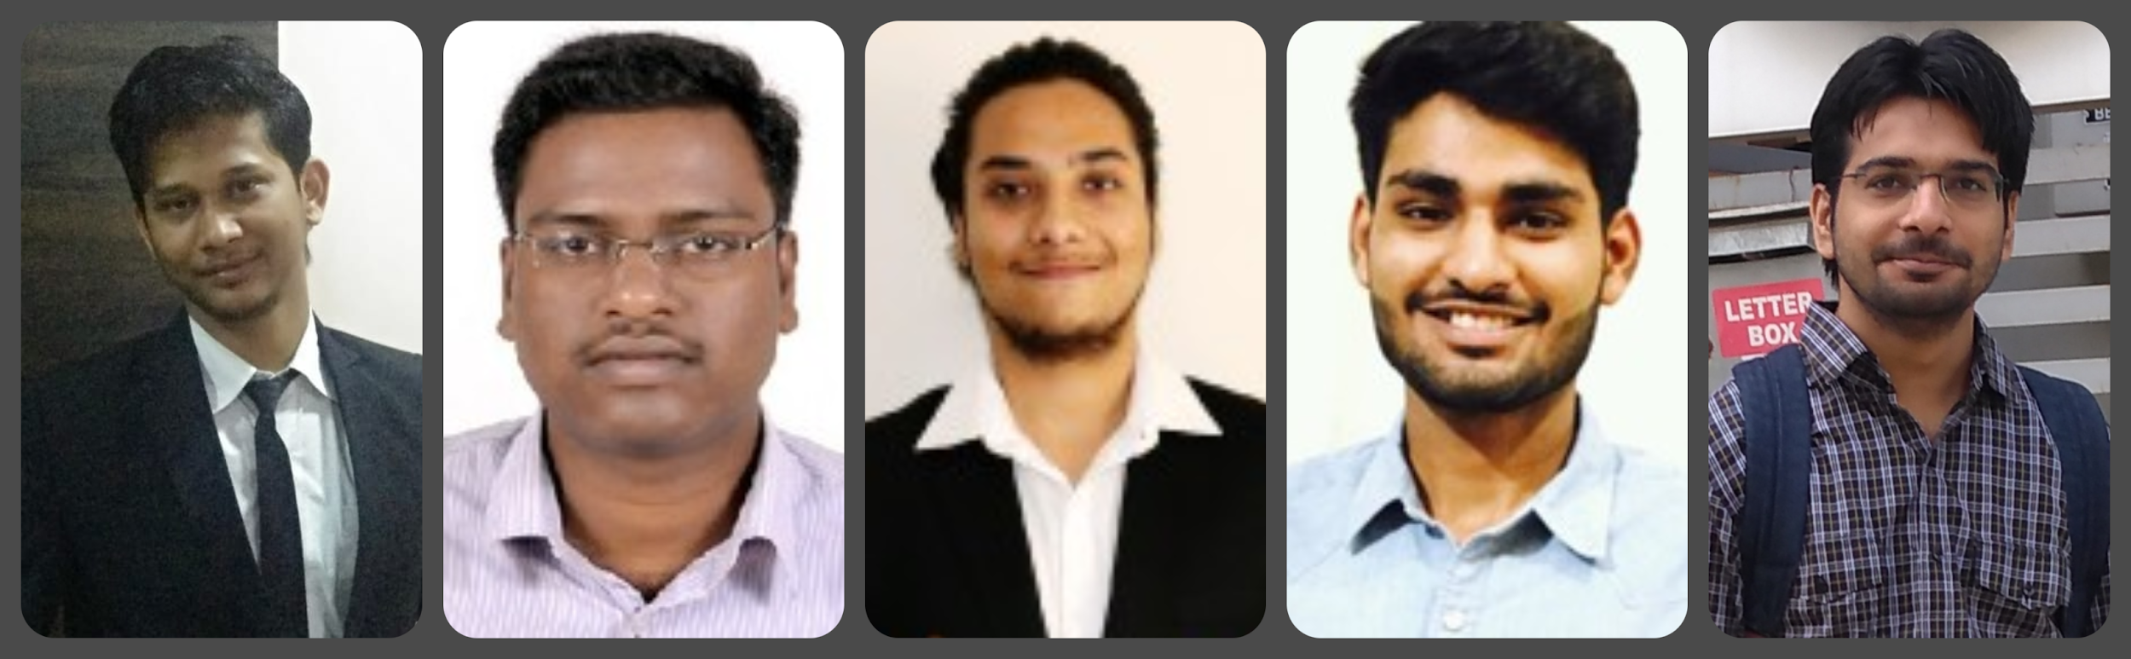
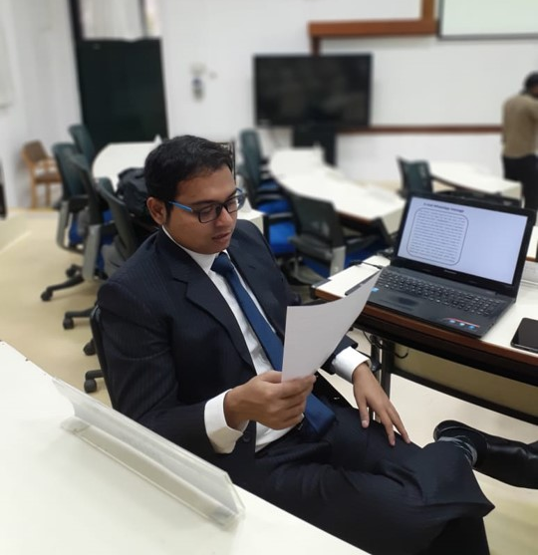
Manish Kumar
Kedar kumar
Golla
Varishu Pant
Ankit Sekseria
Rahul
Aggarwal
Thanks to my teammates for making it a fun learning experience!
A huge Thanks to our mentor Prof. Gourab Nath Sir for guiding us throughout the project.

Slide 38












Slide 39















